Slide 1
Deep Learning
6. Neural Networks Applications in
Computer Vision
andrei.nicolicioiu@gmail.com

Slide 2
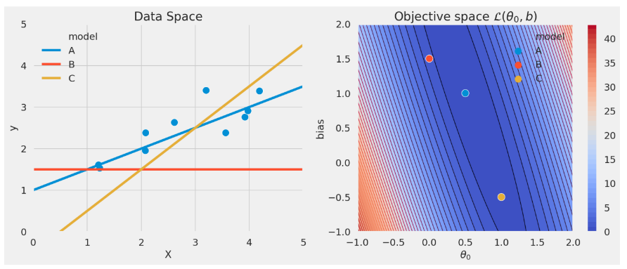
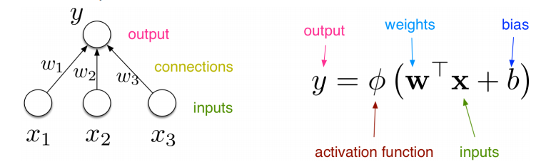
Recap

Slide 3
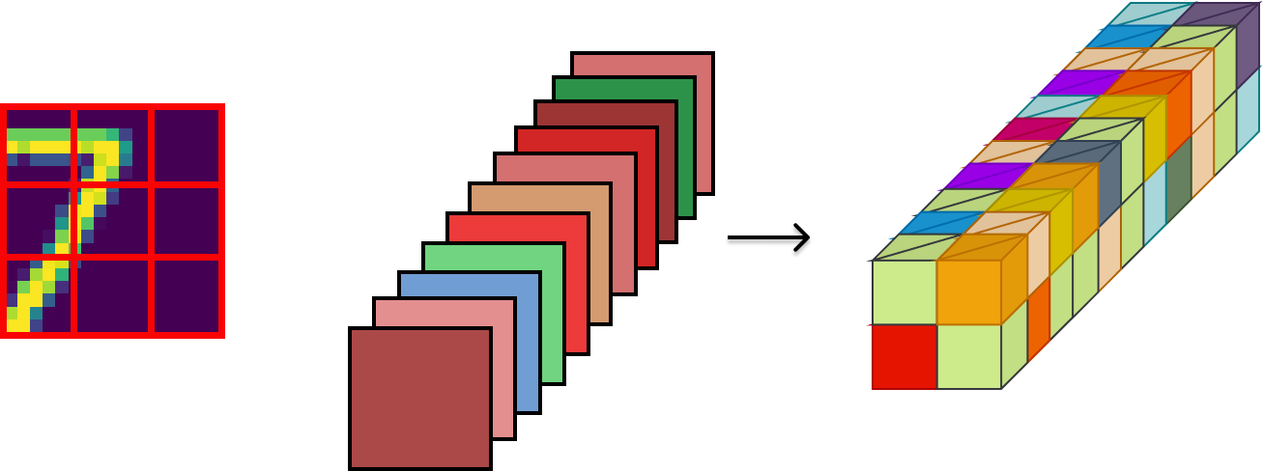
Recap: Convolutional Networks
A convolutional operation:
Output feature map
Input
Kernels

Slide 4
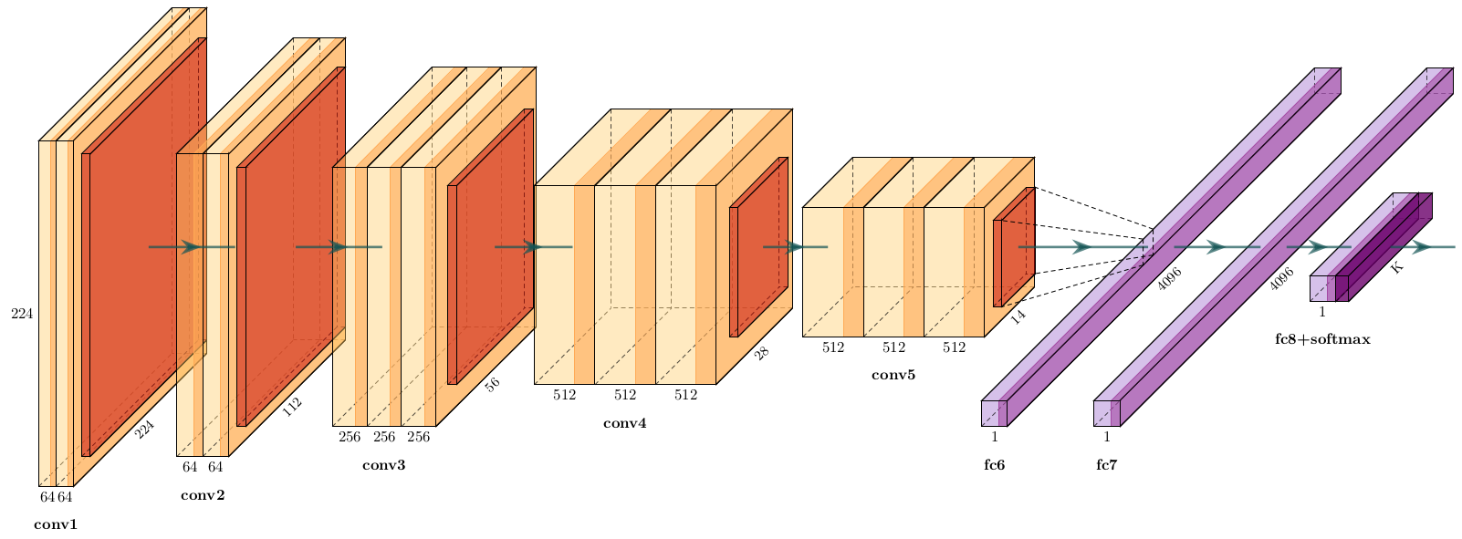
Recap: Convolutional Networks
Simonyan and Zisserman [2014]: Very deep convolutional networks for large-scale image recognition.
Image from: https://github.com/HarisIqbal88/PlotNeuralNet

Slide 5
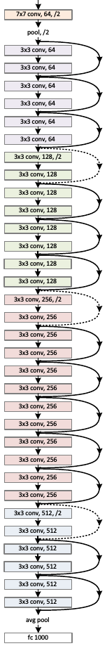
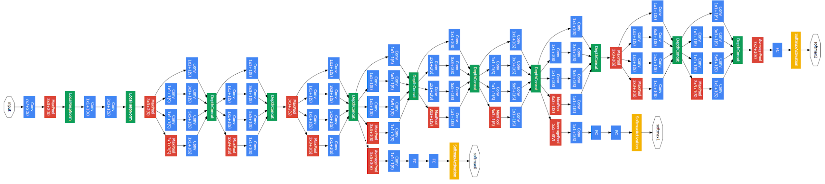
Recap: Convolutional Networks architectures
ResNet
Inception

Slide 6
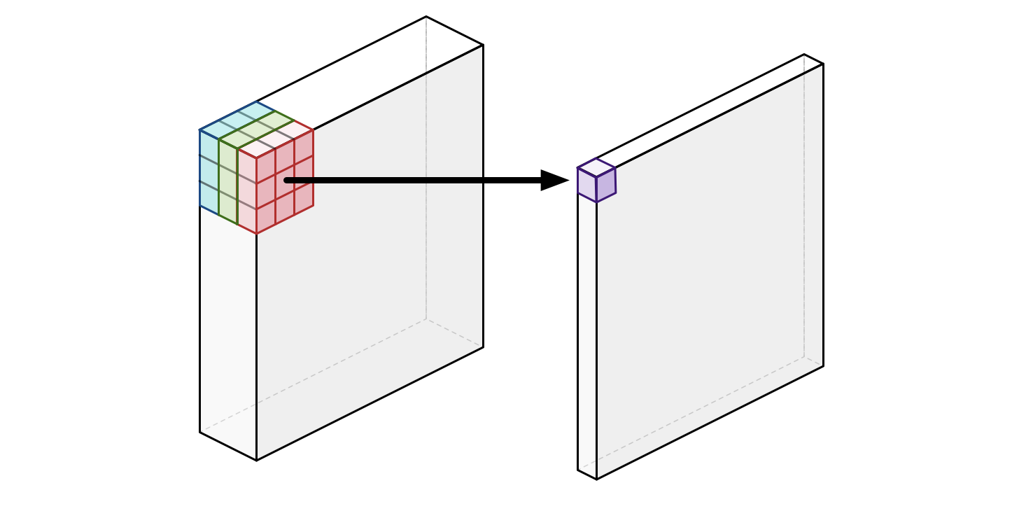
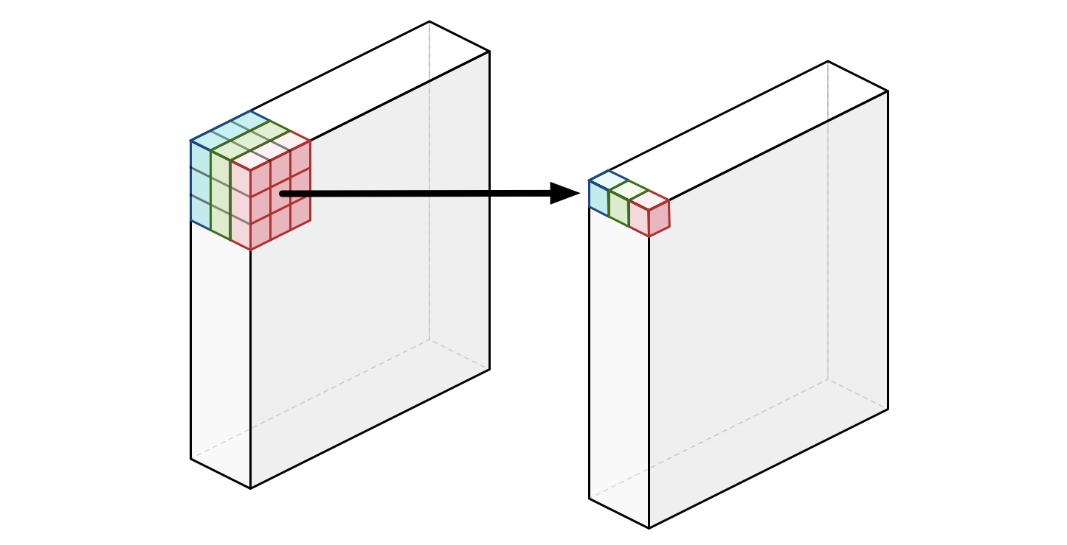
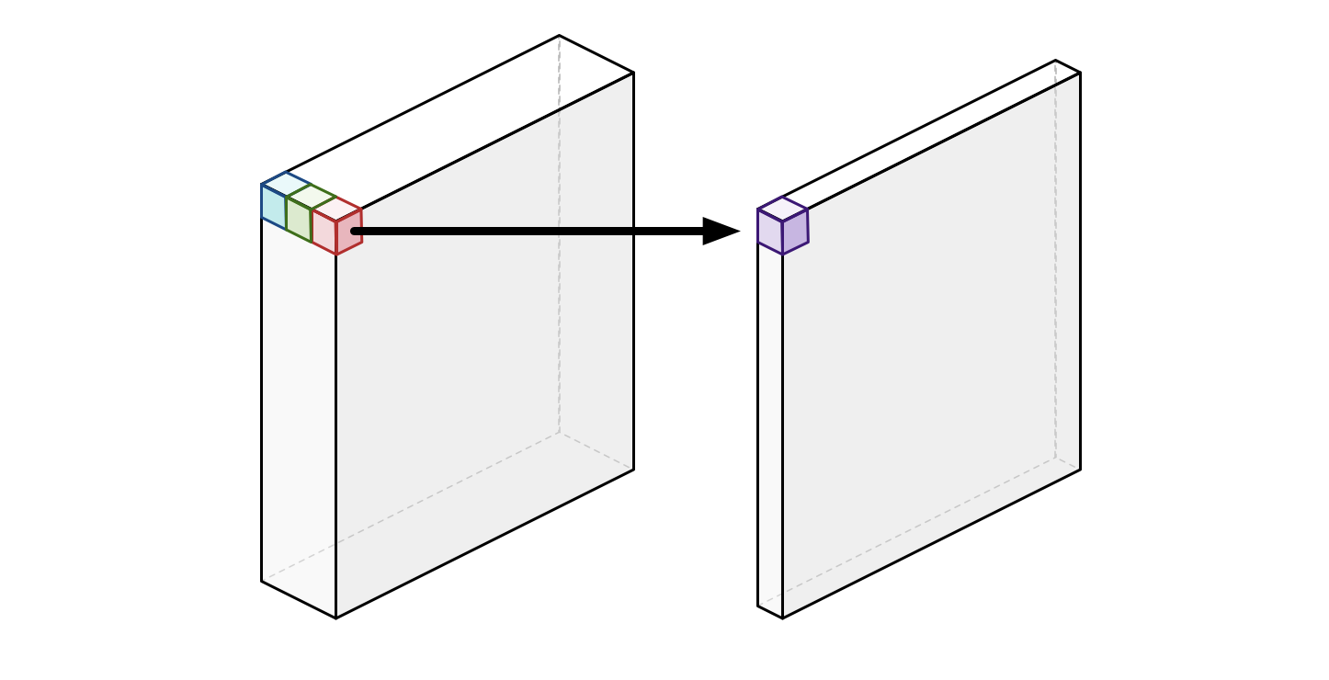
Convolutional Networks in 2018: Mobilenetv2
Use Depthwise separable convolutions
Replace one 3D convolutions with kernel of size [H x W x num_input_channels] apply 2 convolutions:
2D convolution applied independently on each input channel
using kernels of size [H x W]
1D convolution applied independently at each location
Using kernels of size [1x1xnum_input_channels]
Normal conv
Depthwise separable conv
Sandler et al. [2018]: Mobilenetv2: Inverted residuals and linear bottlenecks

Slide 7
Transfer learning
-how to reuse pre-trained models -

Slide 8
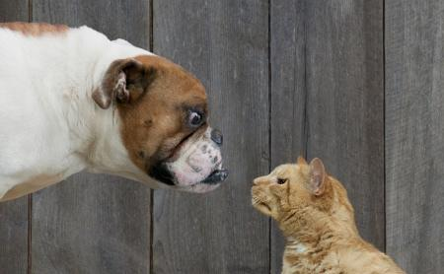
New task: Classify image as cat or dog
Kaggle competition: https://www.kaggle.com/c/dogs-vs-cats-redux-kernels-edition

Slide 9
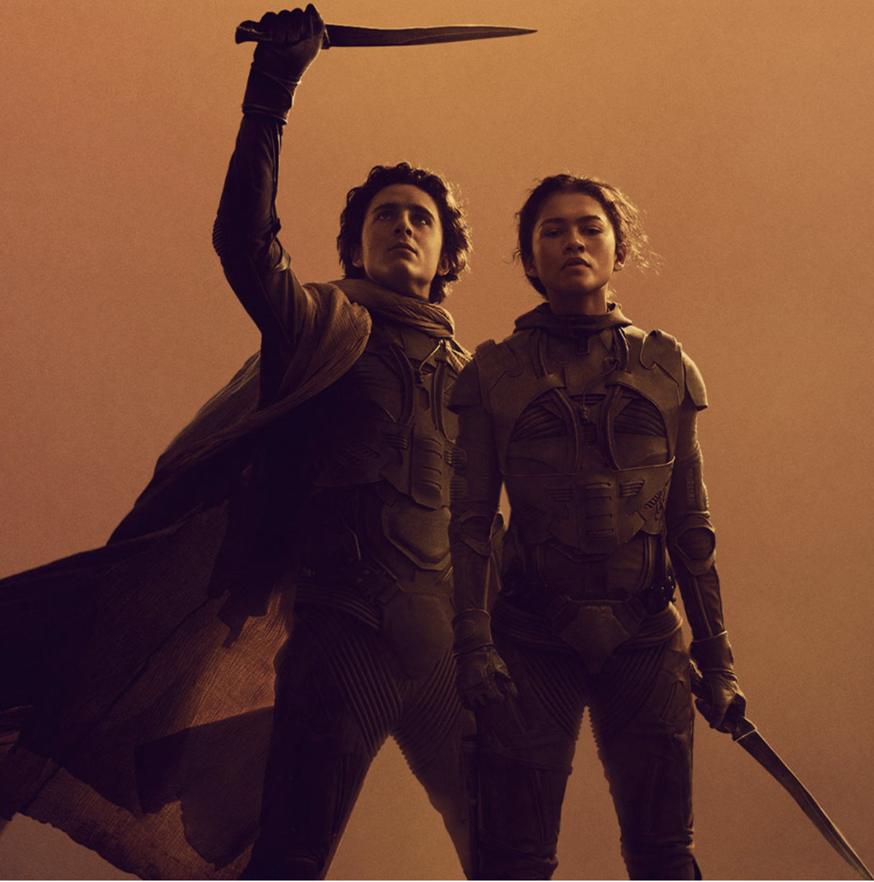
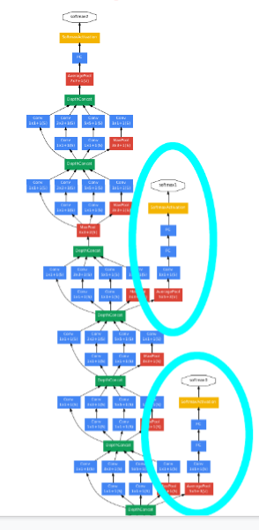
Cats vs Dogs
Deep ConvNets to the rescue
First approach:
Train Resnet or Inception from scratch on all available dogs and cats data
Downsides:
Require large amount of data
Long training time

Slide 10
Transfer Learning
When learning a new skill, humans reuse knowledge and practices that they already learned before.
when learning physics we use knowledge learned from mathematics
when learning to play ukulele we benefit from already playing guitar
How can we made ML models benefit from previously learned tasks?
Start with good representations of data
This could be given by a model already learned on a previous task
Build new representations for a new problem, by building on the old representations

Slide 11
Transfer Learning
In practice, for computer vision tasks
Start from a pretrained model on another task
With large amount of data
The previous task should be similar to the new task
Remove the prediction layer
Usually, the last layer is useful just for the old task
Build a new model by adding one or more layer to the model
Usually replace the last layers
Or add intermediate additional laters: see LoRA
Train the new model on the new task
Learn only the new layers (if the task is very similar) or
Learn the parameters of the entire model (full fine-tunning)

Slide 12
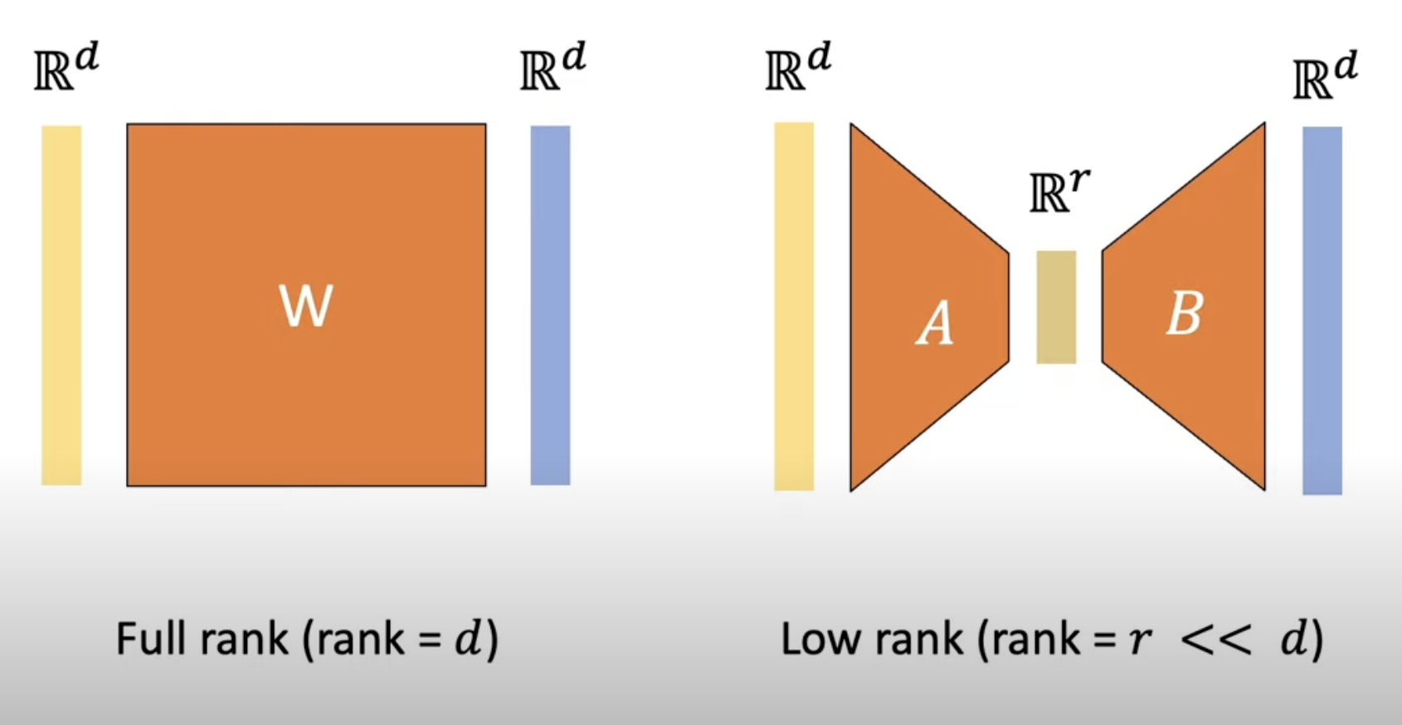
Transfer Learning: LoRA
For some MLP layers LoRA adds a residual connection with extra parameters
W*X replaced by W*X + A*B*X
Initialize A, B such that ABX = 0
A and B are lower dimensional matrices: for example if W = 1024 x 1024, A = 1024 x 128 and B: 128 x 1024
A*B represents a low rank matrix
Very popular for fine-tuning large language models (LLMs)
Hu et al. "Lora: Low-rank adaptation of large language models. 2021
Image from: https://www.youtube.com/watch?v=DhRoTONcyZE&ab_channel=EdwardHu

Slide 13
Self-supervised learning
-what to do when you don’t have labels -

Slide 14
Unsupervised learning? Self-supervised learning
Humans and especially babies learn on their own (without supervision) by observing and interacting with the world. E.g. babies:
Observe and imitate their parents, without knowing what they are doing
Interact with their environment: play with objects or even taste them
Can ML models emulate this?
Design tasks where the goal is to predict something about the data itself
Usually the techniques are very similar or the same as used in supervised learning but the task has to be constructed from the data alone, without having access to any kinds of labels
Generally to approaches: generative and discriminative

Slide 15
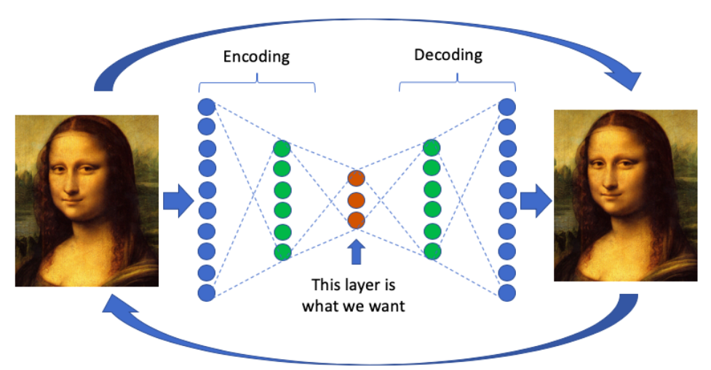
Generative methods
Generative: learn to generate some parts of the input
Common model: auto-encoder
Learn a model that reconstructs the input
Use a small “bottleneck” with that cannot represent the input in its entirely and must learn to compress it
Use this bottleneck representations in a downstream task
Image from: https://towardsdatascience.com/anomaly-detection-with-autoencoder-b4cdce4866a6

Slide 16
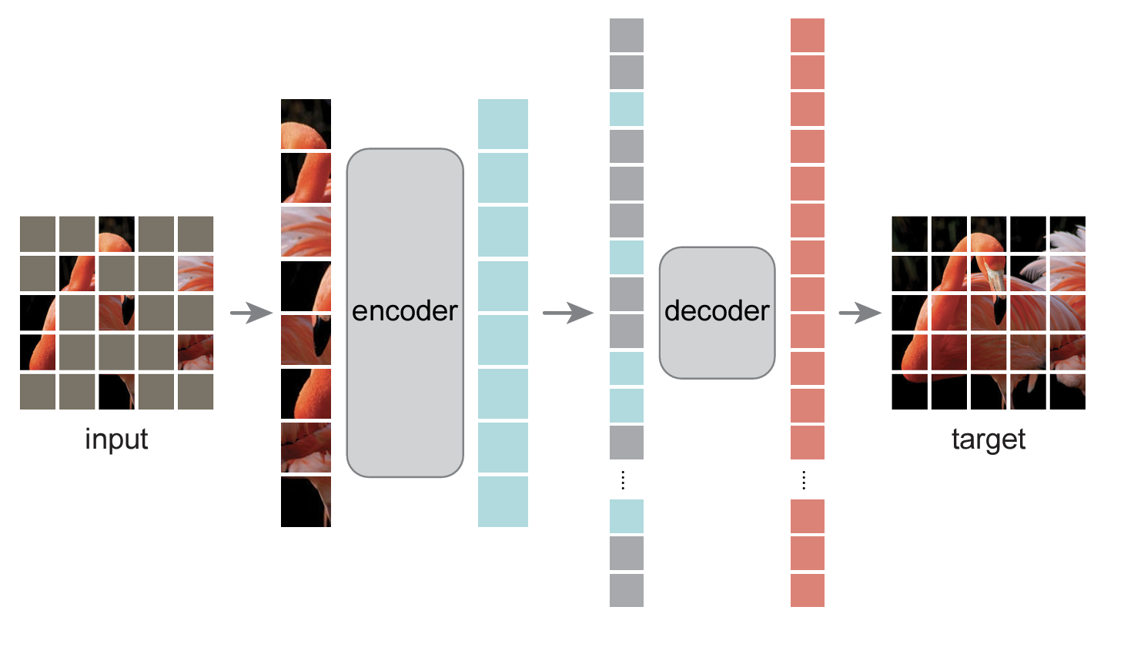
Generative methods: masked auto-encoders
Generative: learn to generate some parts of the input
Masked auto-encoder
Apply noise to the input (random gray patches) and learn to reconstruct the entire original input
Image from: He, Kaiming, et al. "Masked autoencoders are scalable vision learners." CVPR 2022

Slide 17
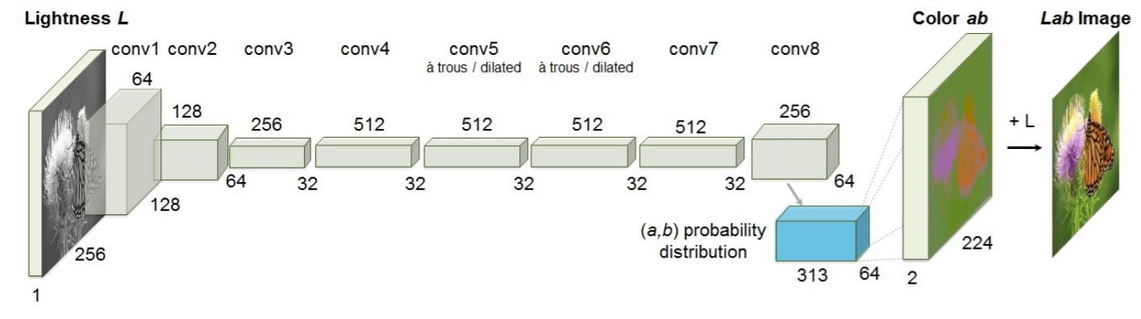
Generative methods: image colorization
Train a convolutional network to predict the colors from a gray image
Re-use part of the model to obtain good representations
Zhang et al. "Colorful image colorization." ECCV 2016

Slide 18
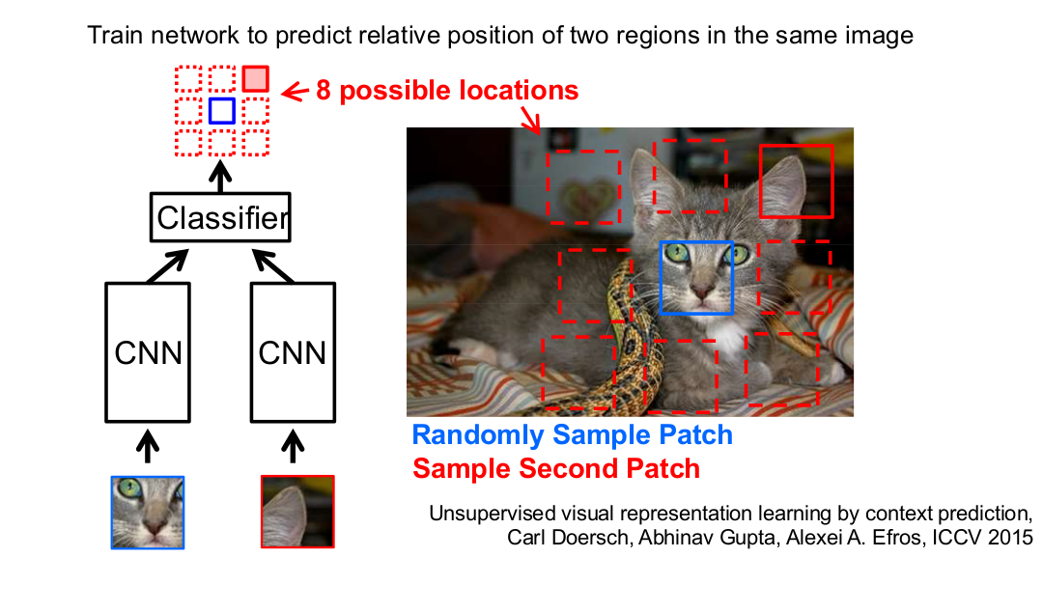
Discriminative methods
Discriminative: design a task where the model should distinguish between some modifications of the data.
Slide from Andrew Zisserman’s presentation

Slide 19
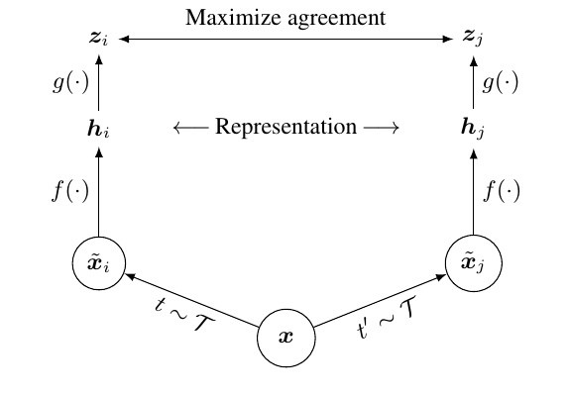
Contrastive Methods
Current successful discriminative approaches: Contrastive methods
Given a pair of images: do they match or not?
positive or negative pair?
Difficulty: finding meaningful categorisation in positive and negative pairs
Positive:
different parts of the same image
the same image transformed in different ways
Negative:
Random pairs of images
Chen et al. "A simple framework for contrastive learning of visual representations." ICML 2020.

Slide 20
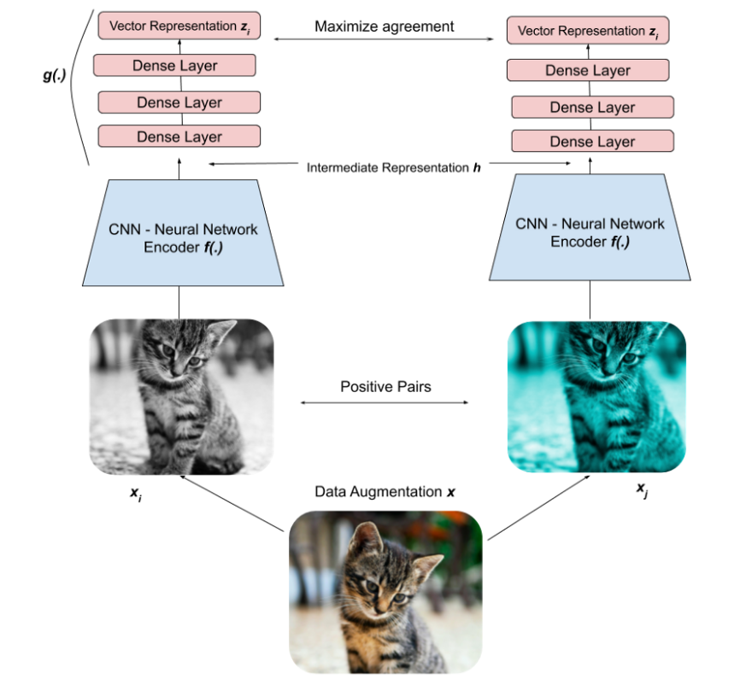
Contrastive Methods
Minimise generic Loss:
A contrastive method will produce a representation f(x) that is good for distinguishing between positive and negative pairs
A generic contrastive method should learn to
make the representations of positive pairs more similar
Make the representation of negative pairs less similar
Chen et al. "A simple framework for contrastive learning of visual representations." ICML 2020.
Notes:
Image from: https://towardsdatascience.com/understanding-contrastive-learning-d5b19fd96607

Slide 21
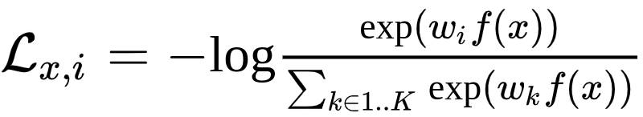
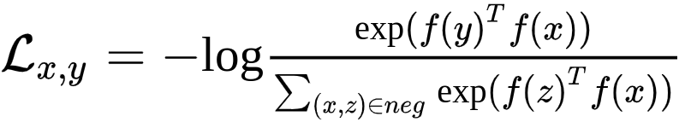
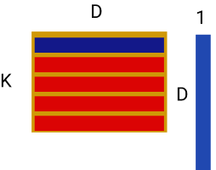
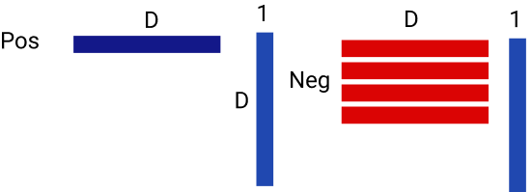
Contrastive Methods
Supervised cross-entropy loss
Self-supervised contrastive loss
For more details you could see: https://gidariss.github.io/self-supervised-learning-cvpr2021/

Slide 22
Robustness
-take care: your network cheats -

Slide 23
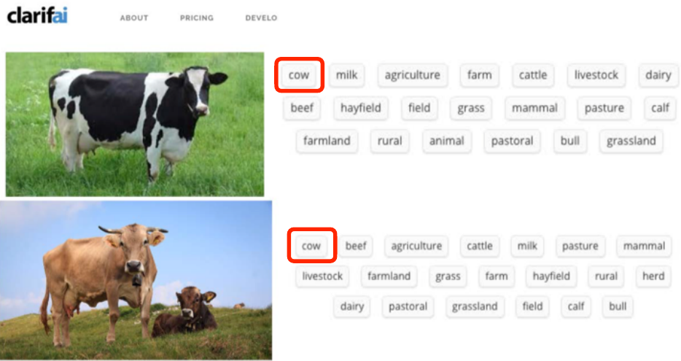
Shortcuts in Learning
Image from Aaron Courville talk (EEML 2021) - who got it from Bernhard Schölkopf ’s slides (2017) - who got it from Pietro Perona (2017) :)

Slide 24
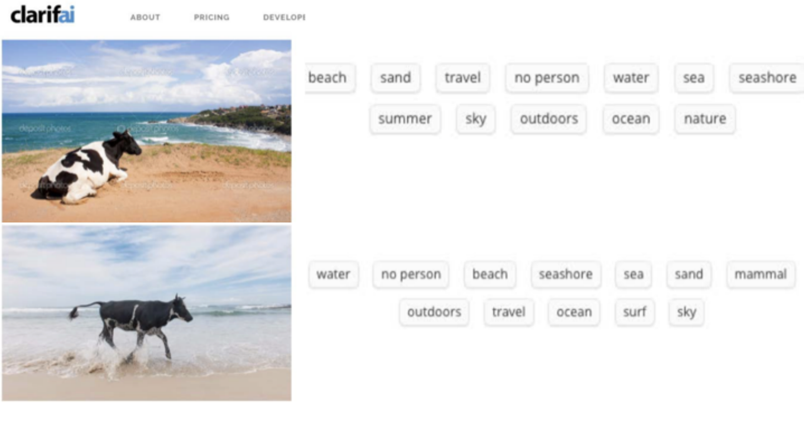
Shortcuts in Learning
Image from Aaron Courville talk (EEML 2021) - who got it from Bernhard Schölkopf ’s slides (2017) - who got it from Pietro Perona (2017) :)

Slide 25
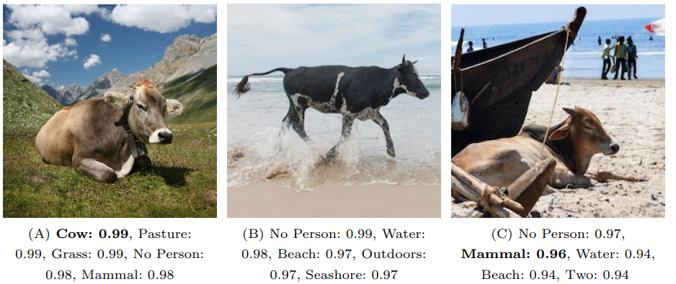
Shortcuts in Learning
Shortcuts: learning strategies / rules that solve the task in an unintended way that is not based on true causes and cannot generalize
These schotcuts are based on spurious (fake / misleading) features
Also called non-robust or non-causal features
e.g. use color of the background to distinguish between cows and camels
Beery et al. "Recognition in terra incognita." ECCV. 2018. Geirhos et al. "Shortcut learning in deep neural networks." Nature Machine Intelligence (2020).

Slide 26
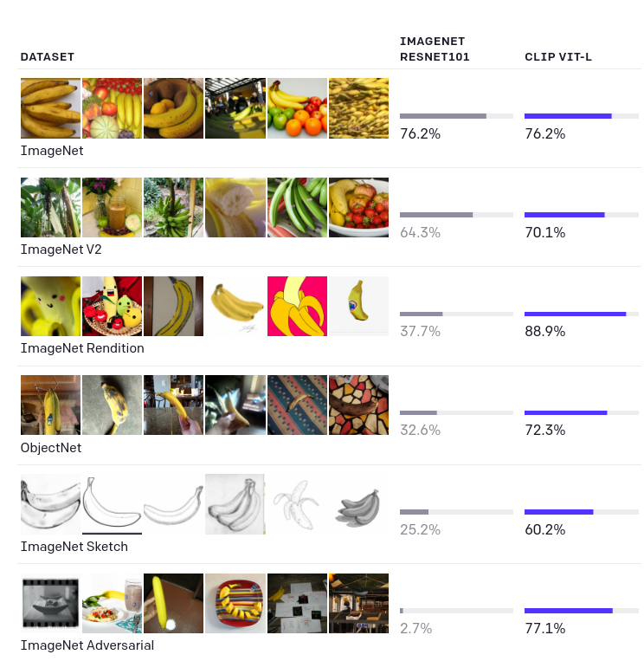
Shortcuts in Learning
Large scale models like OpenAI’s CLIP trained on 400M image-text pairs are:
more robust to shortcuts
capable of better generalising
https://openai.com/blog/clip/

Slide 27
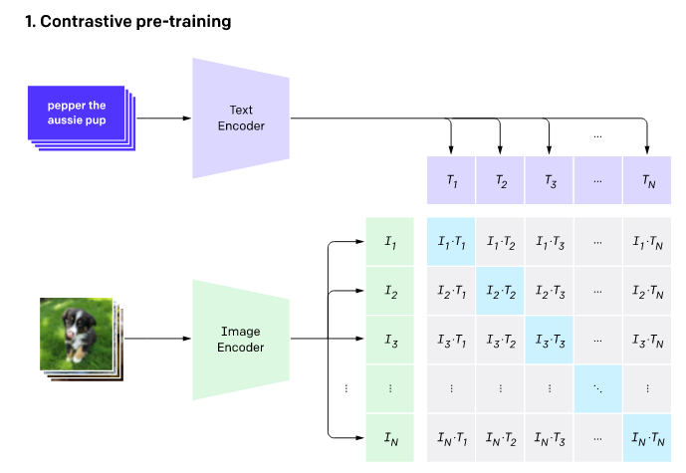
CLIP
Morel trained on a vast collection of image-text pairs
Contrastive learning method on these image-text pairs
Learn to produce
high similarity for correct image - text pairs
Low similarity for random image-text pairs
https://openai.com/blog/clip/

Slide 28
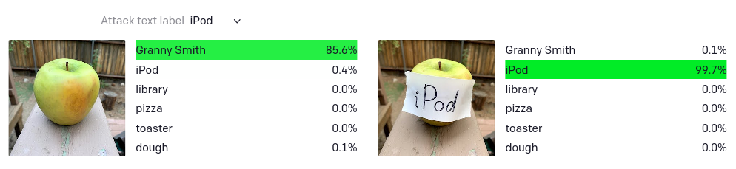
Shortcuts in Learning
But even CLIP models are still vulnerable to shortcuts
https://openai.com/blog/multimodal-neurons/

Slide 29
Systematic generalisation
Systematic Generalization: Generalization to examples that may not be drawn from the same distribution as the training data, but that obey the same basic rules of production or underlying structure.
Systematic generalisation - special king of out-of-distribution generalisation
Promoting systematic generalisation :
Increase data or model diversity and potential use data augmentations
Learn features that are do not change across different environments
They are more robust - and ideally represent the true causes
Modularity and other Inductive biases

Slide 30
Case study: face analysis
Buolamwini and Gebru [2018] study the performance of standard gender classifiers offered by API bundles by Microsoft, IBM and Face++
They show large differences in the performance on different subgroups
All classifiers perform better on male faces than female faces
8.1% − 20.6% difference in error rate
All classifiers perform better on lighter faces than darker faces
11.8% − 19.2% difference in error rate
All classifiers perform worst on darker female faces
20.8% − 34.7% error rate
Buolamwini and Gebru. "Gender shades: Intersectional accuracy disparities in commercial gender classification." FAccT 2018.
Notes:
Urbina, Fabio, et al. "Dual use of artificial-intelligence-powered drug discovery." Nature Machine Intelligence (2022): 1-3.

Slide 31
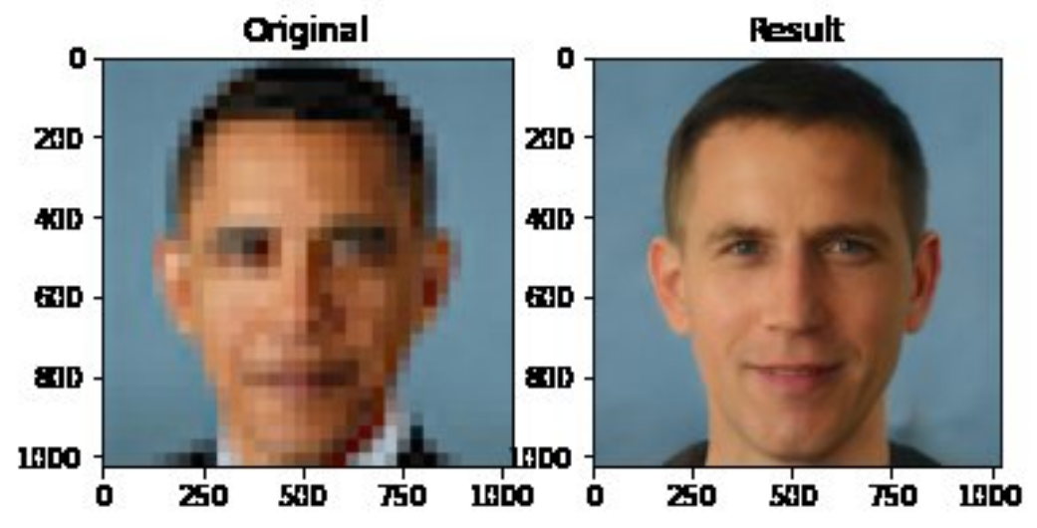
Case study: Super-Resolution
Notes:
https://twitter.com/Chicken3gg/status/1274314622447820801

Slide 32
Case study: Super-Resolution
Current ML methods could upsample low resolution images
Keep in mind that some information cannot be recuperated from low-resolution
ML methods inherently ‘guess’ the missing details
In certain cases this could be useful: photo sharing - video games
But this can also be used for dangerous applications - wrongly identifying suspects
Notes:
https://twitter.com/Chicken3gg/status/1274314622447820801

Slide 33
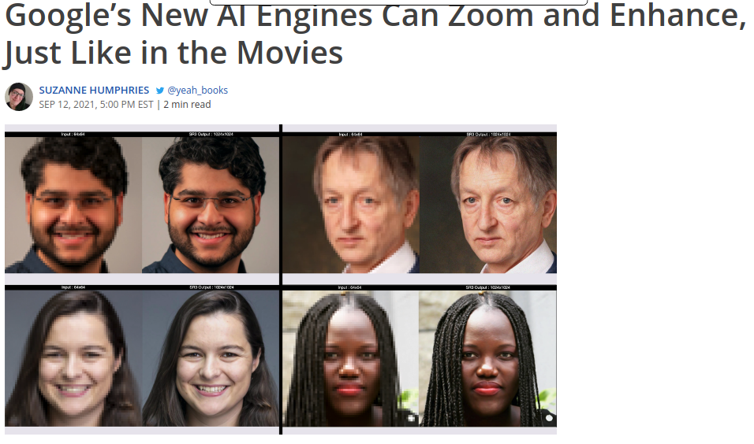
Case study: Super-Resolution
FALSE
Always present clearly what a method can do and cannot do
Take care of unintended use cases
Notes:
https://twitter.com/Chicken3gg/status/1274314622447820801

Slide 34
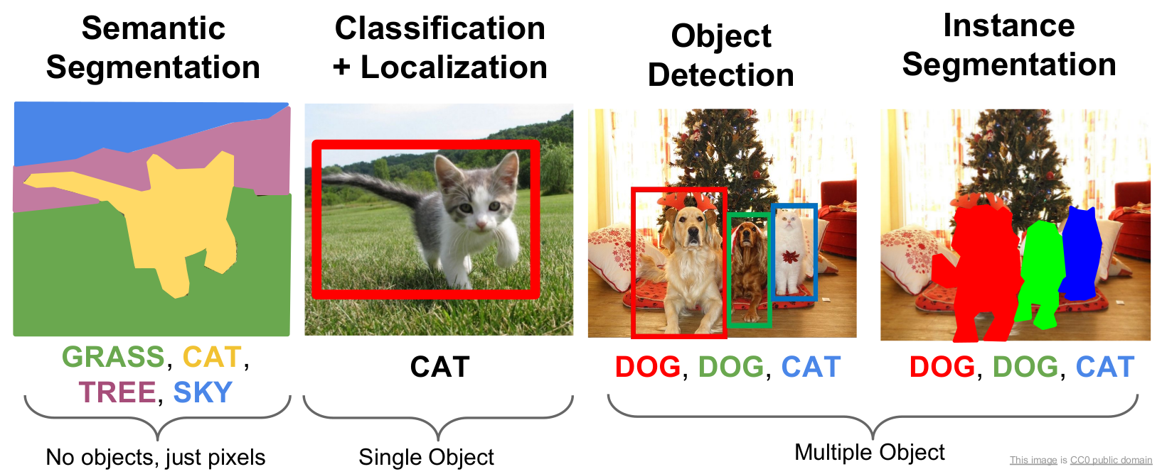
Computer Vision Tasks
Slide from: CS231n Stanford Course

Slide 35
Segmentation
-or how to put borders in your images -

Slide 36
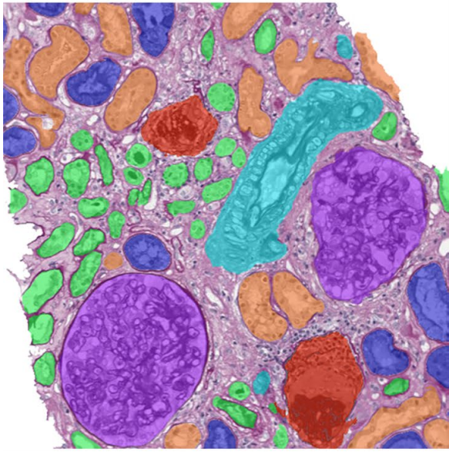
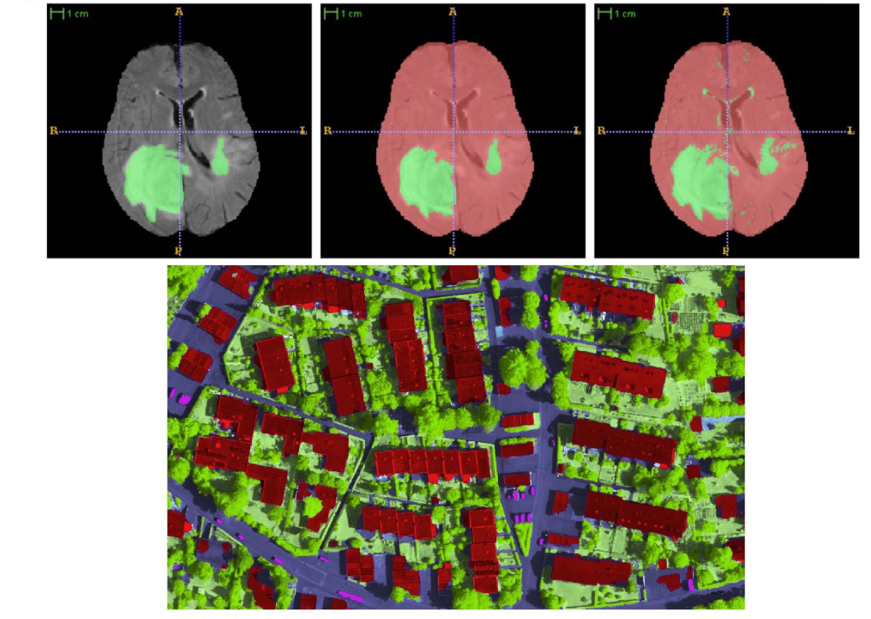
Segmentation
Definition:
partition an image into regions each of which has a reasonably homogeneous visual appearance or which corresponds to objects or parts of an object [Forsyth and Ponce 2003]
Image from: Bauer et al. [2011], Marmanis et al. [2016], van der Laak [2021].
Notes:
See also: van der Laak [2021] Deep learning in histopathology: the path to the clinic. Nature medicine 2021. https://www.nature.com/articles/s41591-021-01343-4.pdf

Slide 37
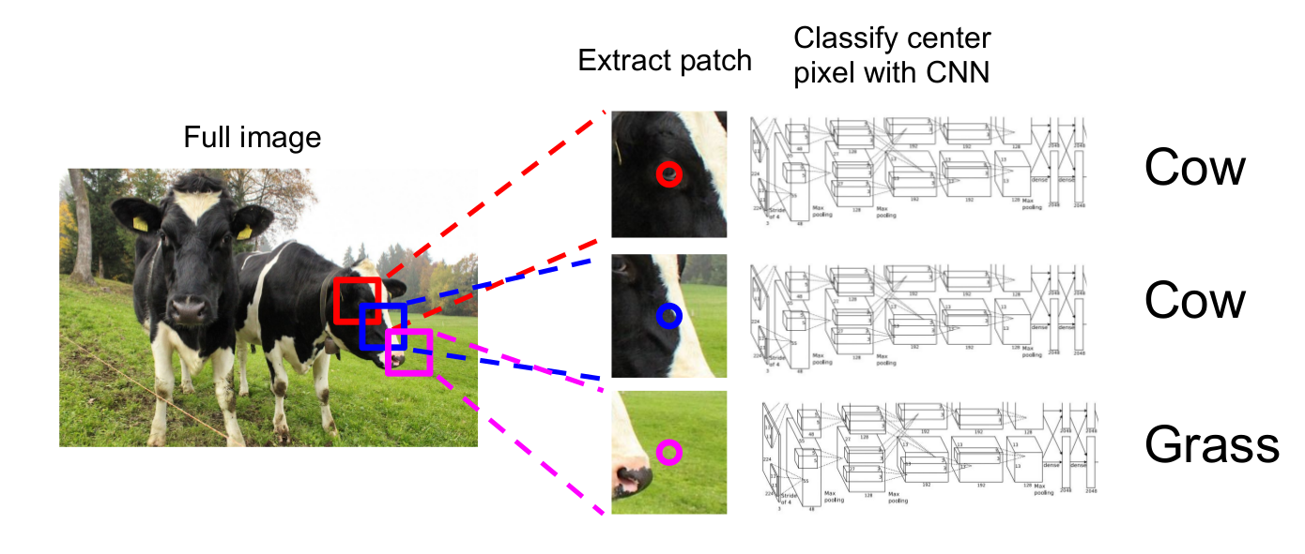
Segmentation: Sliding Window
Slide from: CS231n Stanford Course

Slide 38
Segmentation: Sliding Window
Select patches obtained by sliding a window through the image
Learn to classify each path as the class of the object or region found at its center
Create (patches, center labels) pairs
Learn the convolutional network to predict the class of the center of a patch
Classify each pixel by selecting a patch around it and run the learnt network
Problem: Inefficient

Slide 39
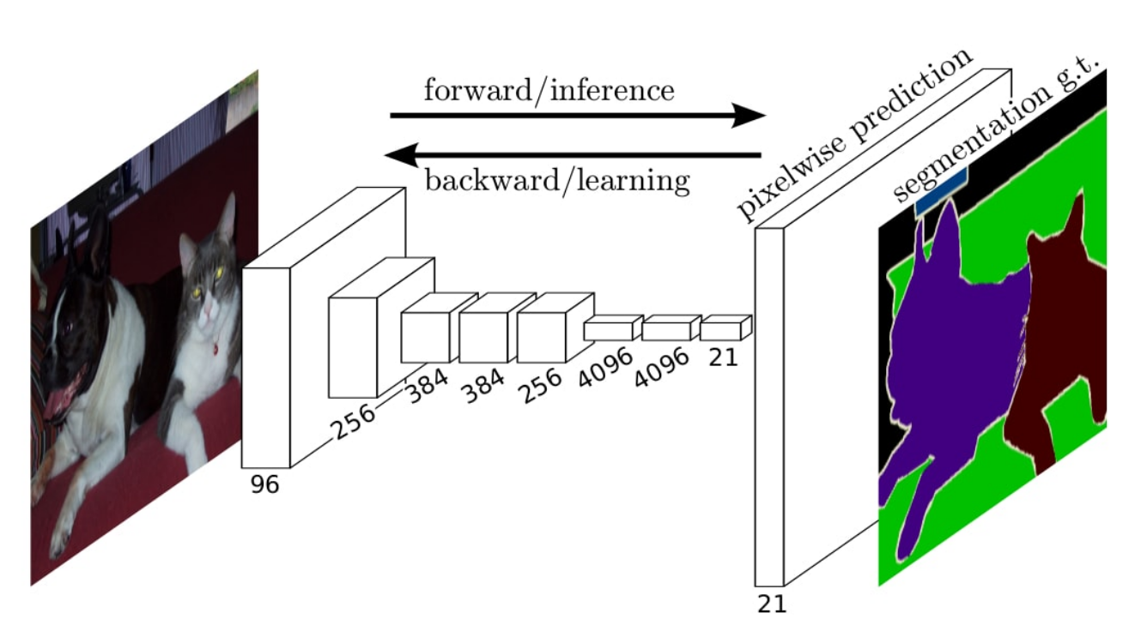
Segmentation
Goal:
Generate a segmentation for the entire image without redundant computations
Use information learned on classification tasks with more data, and be able to transfer it to segmentation task
Image from: Long et al.[2014]: Convolutional networks for semantic segmentation.

Slide 40
Segmentation
convolution, pooling and activations layers are local operations
apply them on the whole image
a fully-connected layer could be seen as convolutional layer
Instead of fc layers, use conv layers with filters of the same size as the input to the gc

Slide 41
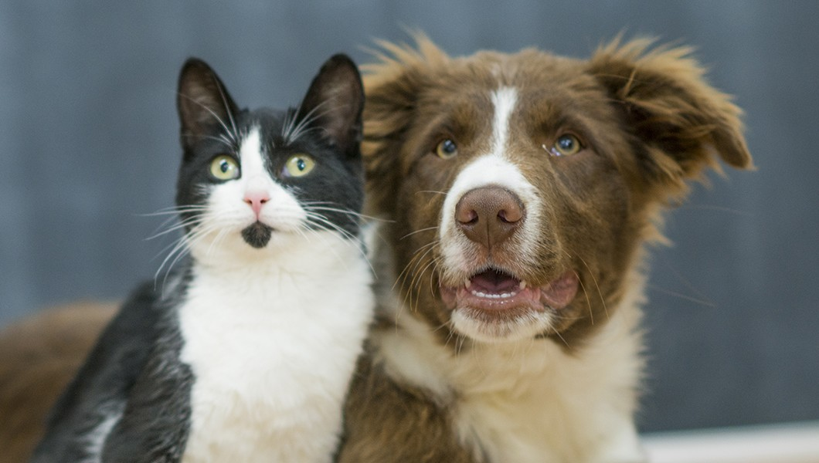
Segmentation - sliding window
Let's take two patches from a larger image and pass each of them through the same convolutional neural network
We will observe that there exist points in the intermediate features maps of the net that:
Are obtained by the exact computations of the exact same input
Are redundant

Slide 42
Segmentation - sliding window
Convolutional and pooling layers share computations
There exists points in the feature maps of the two image patches that have the same receptive field in the input image
These points have the same values obtained by the same computations
Results: for neighbouring patches most convolutional and pooling computations are shared

Slide 43
Segmentation - sliding window
Convolutional and pooling layers share computations
There exists points in the feature maps of the two image patches that have the same receptive field in the input image
These points have the same values obtained by the same computations
Results: for neighbouring patches most convolutional and pooling computations are shared

Slide 44
Segmentation - sliding window
Fully connected layers depend on the whole input
Output of the fully-connected layers for the two images are completely different
Result: the two patches do NOT share any computations in the fully connected layers

Slide 45
Segmentation
Fully connected layers depend on the whole input
Output of the fully-connected layers for the two images are completely different
Result: the two patches do NOT share any computations in the fully connected layers

Slide 46
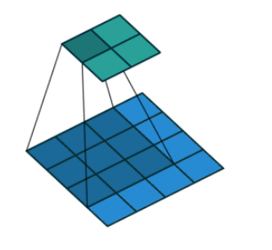
Apply convolutional layer on larger input
convolution, pooling and activations layers are local operations
apply them on the whole image

Slide 47
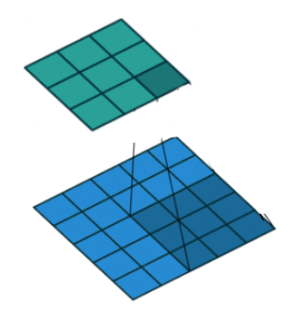
Apply convolutional layer on larger input
convolution, pooling and activations layers are local operations
apply them on the whole image
enlarging the input (blue) does NOT influence the top 4x4 cells of the output

Slide 48
Fully-connected -> convolutional
Instead of applying a fully connected layer on the output corresponding to each small patch, we will apply a conv layer on the entire image that would produce the same output
Let’s consider first only the feature maps corresponding to a small patch, that would be fed to a fully connected layer

Slide 49
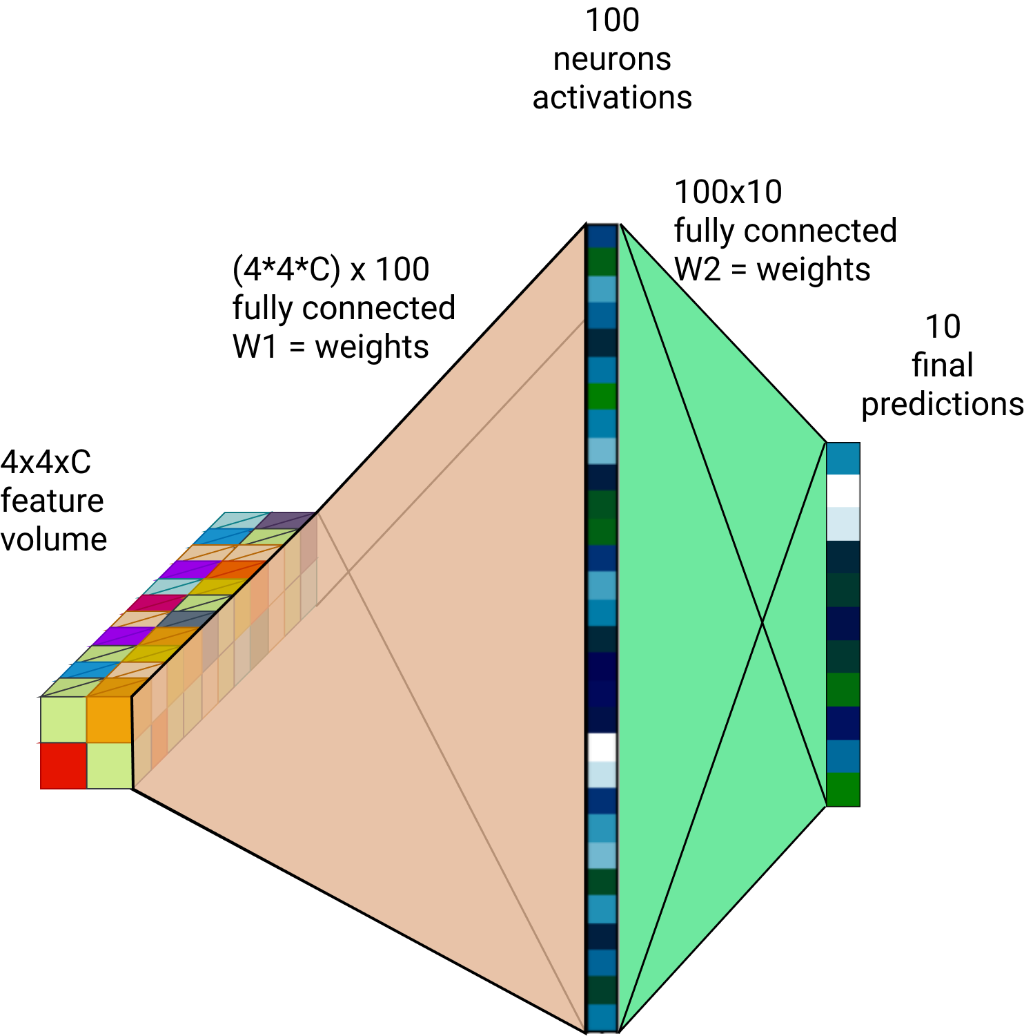
Fully-connected -> convolutional
Input: feature volume of size 4x4xC
Process the features into the final classification by two fully connected layers
fully connected layers can be converted into convolutional layers
Fully connected layer is equivalent with convolutional layer with kernels of the same size as the input

Slide 50
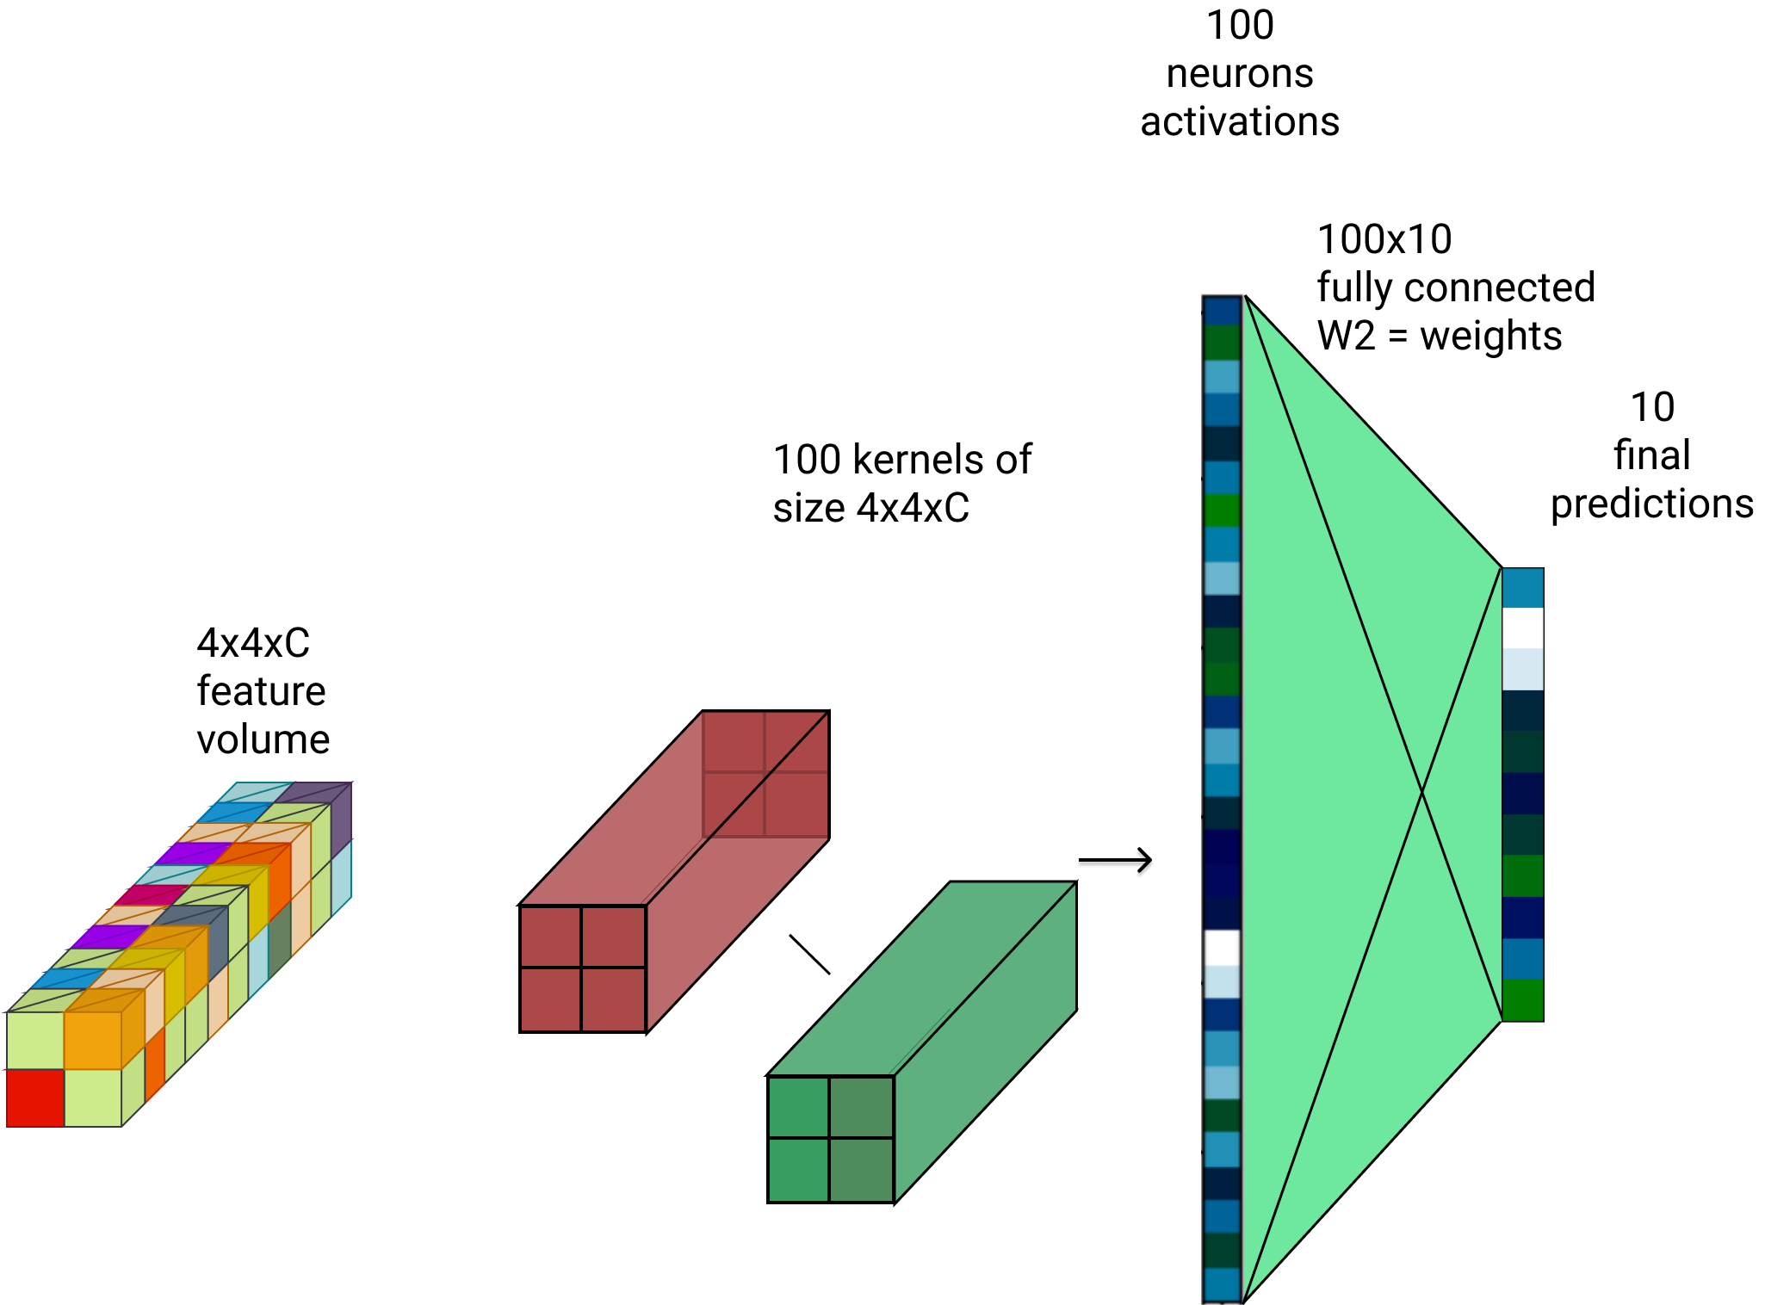
Fully-connected -> convolutional
Use the same parameters from the fully connected but reshape them to be used as convolutional parameters
From (4*4*C)x100 matrix
To 100 kernels of size 4x4xC

Slide 51
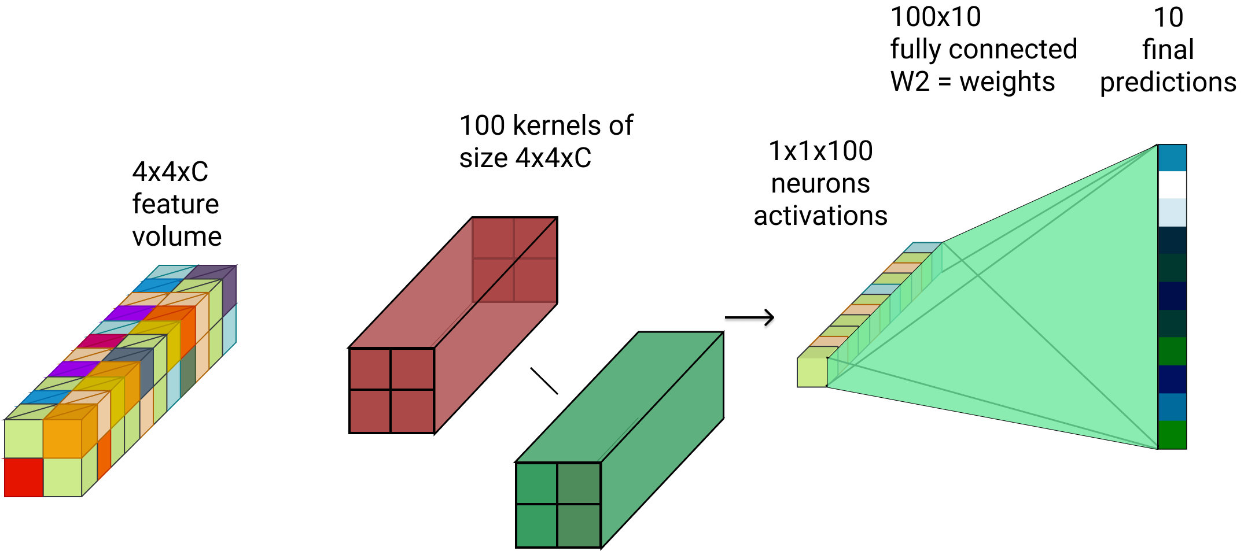
Fully-connected -> convolutional
From a input with 2 spatial dimensions H x H and some channels C we obtain a single vector with 100 channels
Resulting vector can be seen as a single 1x1 spatial location with 100 channels

Slide 52
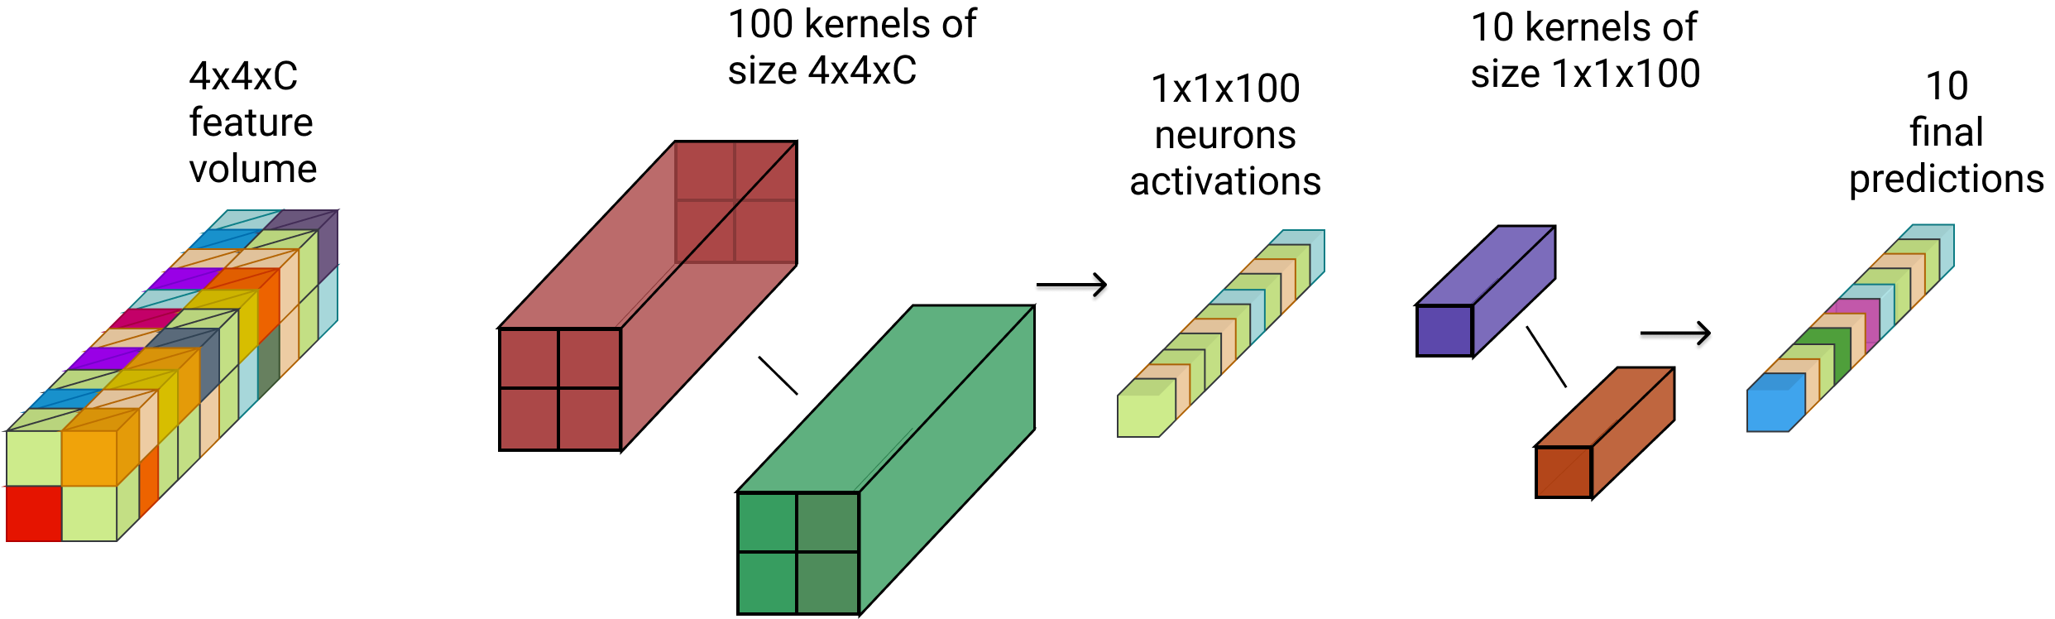
Fully Convolutional Network (FCN)
All fully connected have been replaced by convolutions
This network would work on any input size

Slide 53
Fully Convolutional Network (FCN)
All fully connected have been replaced by convolutions
This network would work on any input size

Slide 54
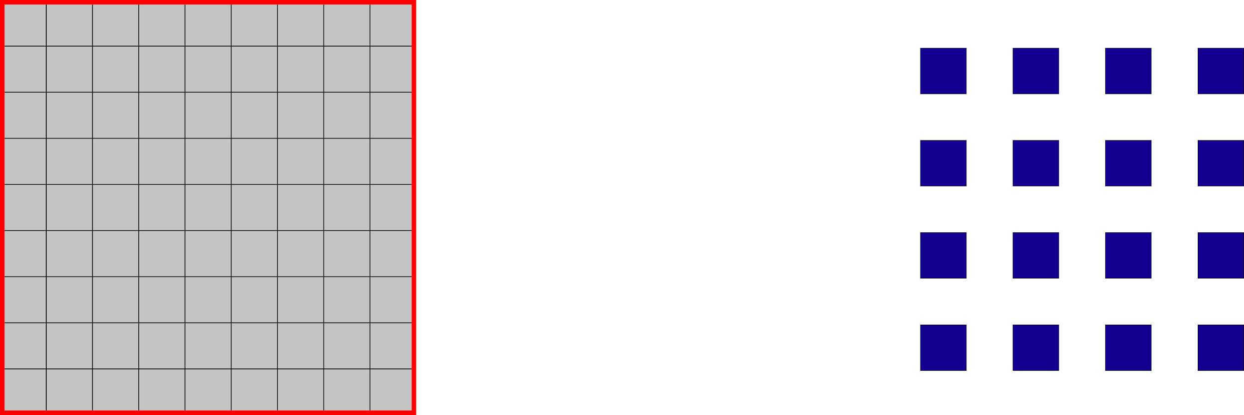
Problem: Sparse Output
Due to the strides the output is sparser than the input
Every stride=k layer makes the output k^2 sparser
For segmentation we want dense output
Every pixel should have a label
Input
Output

Slide 55
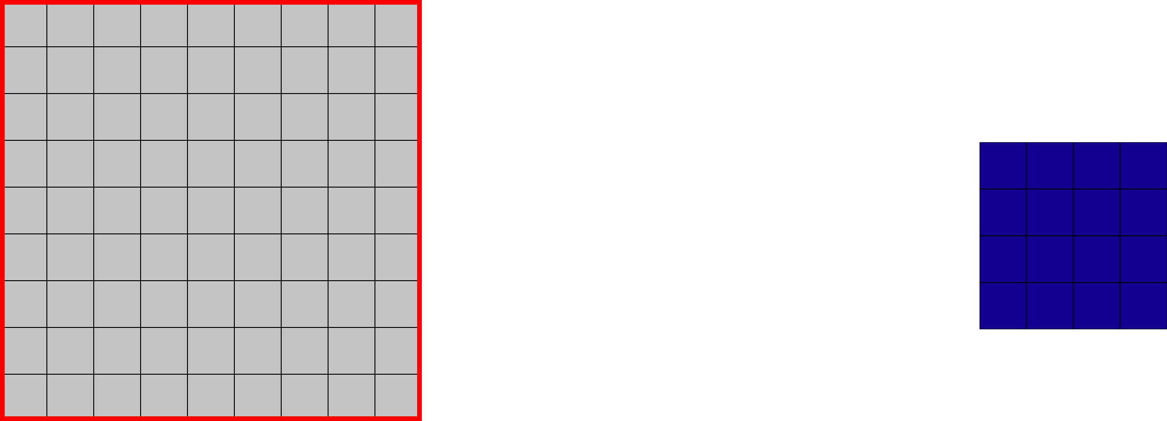
Sparse Output
Solution 1: shift and stitch
Shift the input by 1 pixel and get a different output

Slide 56
Sparse Output
Solution 1: shift and stitch
Shift the input by 1 pixel and get a different output

Slide 57
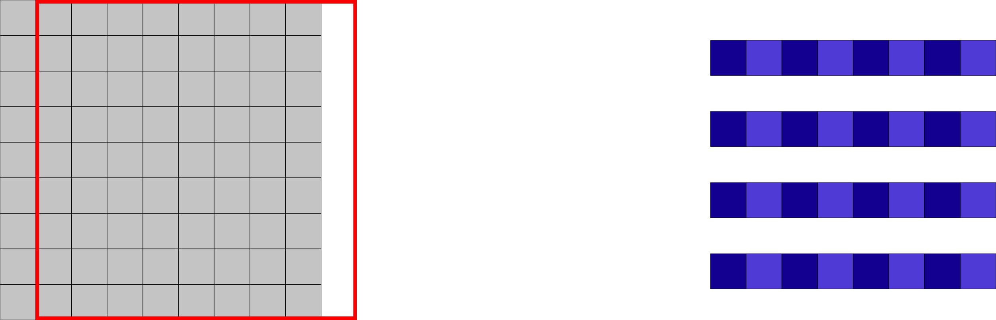
Sparse Output
Solution 1: shift and stitch
Shift the input by 1 pixel and get a different output

Slide 58
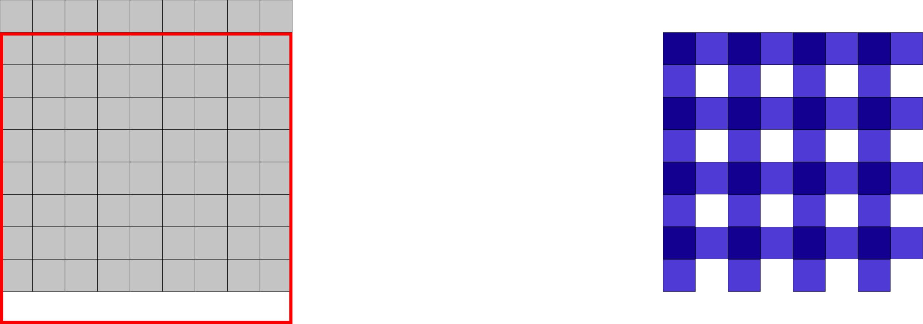
Sparse Output
Solution 1: shift and stitch
Shift the input by 1 pixel and get a different output

Slide 59
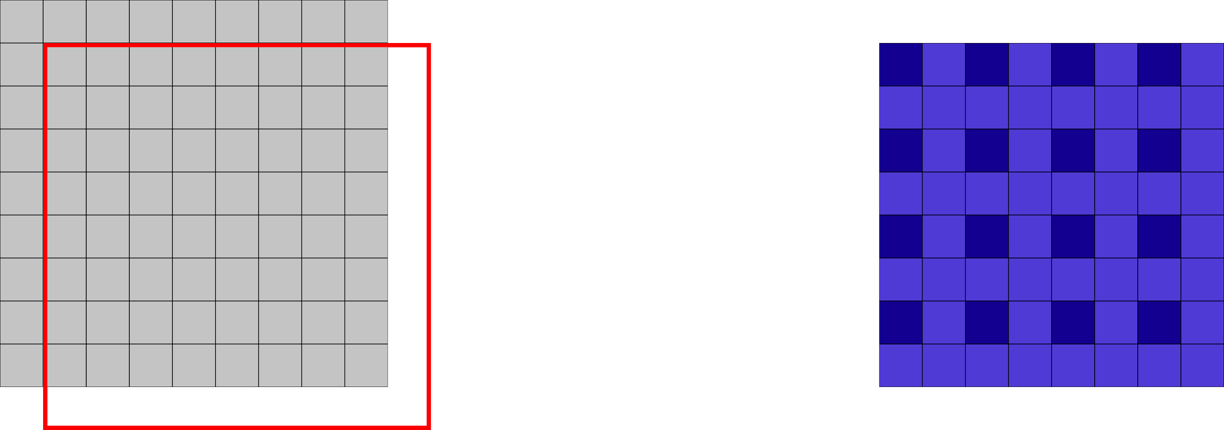
Sparse Output
Solution 1: shift and stitch
Shift the input by 1 pixel and get a different output

Slide 60
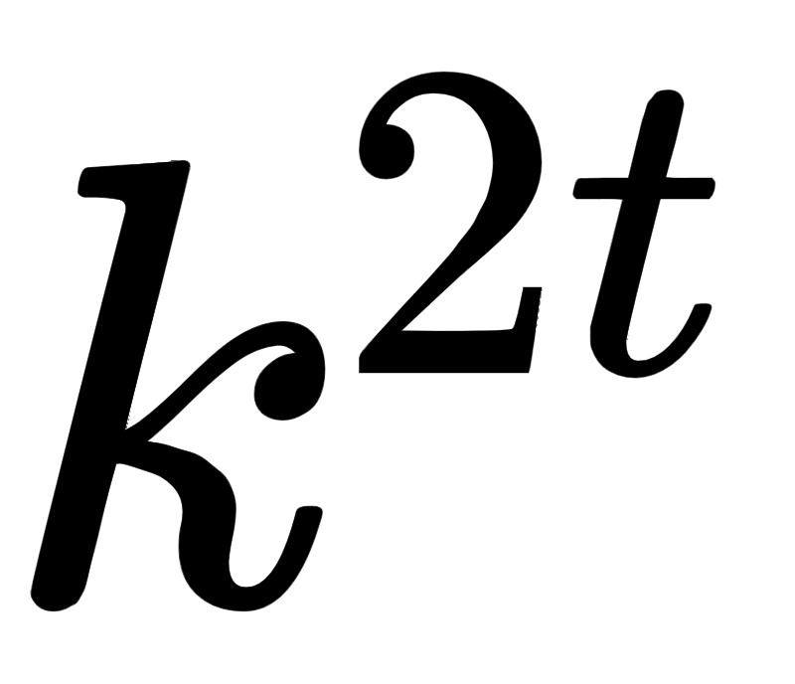
Sparse Output
Solution 1: shift and stitch
Shift the input by 1 pixel and get a different output
Computational intensive: for t layers with stride=k
=> passes

Slide 61
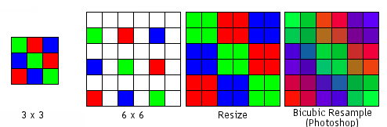
Sparse Output
Solution 2: upsample via interpolation
Pro: Simple and efficient
Con: can not capture complex upscaling
Notes:
http://hobbymaker.narod.ru/English/Articles/resampling_eng.htm

Slide 62

Sparse Output: Deconvolutional Layers
Solution 3: use deconvolutional layer
Name: Deconvolution == Backwards Convolution == Transposed Conv == Fractionally strided Conv
A deconv layer has ‘inverse’ operations as a convolution.
A filter is multiplied with a point in the input and the resulting matrix is added in the corresponding region in the output
Apply stride K in the output: => output is K^2 times larger
Image from: Noh et al. [2015]: Learning deconvolution network for semantic segmentation

Slide 63



Fully Convolutional Network (FCN)
By converting the fully connected layers into convolutions we have a completely convolutional network that can be applied on images of any size
The segmentation is rough because it results from upsampling a law resolution output
Solution: use information from intermediate layers in the network, where low-level details are present
Long et al.[2014]: Convolutional networks for semantic segmentation.

Slide 64
Skip Layers
Combine the outputs of an upper and an intermediate layer
Q: Why would low-level features help?
Useful for aligning the output with image boundaries, or with part of objects
Use a 1x1 convolutional layer on features from lower levels to produce class predictions
Upsample and add prediction scores from different levels then do a softmax

Slide 65

Skip Layers
Combine the outputs of an upper and an intermediate layer
Q: Why would low-level features help?
Useful for aligning the output with image boundaries, or with part of objects
Use a 1x1 convolutional layer on features from lower levels to produce class predictions
Upsample and add prediction scores from different levels then do a softmax

Slide 66

Skip Layers
Combine the outputs of an upper and an intermediate layer
Q: Why would low-level features help?
Useful for aligning the output with image boundaries, or with part of objects
Use a 1x1 convolutional layer on features from lower levels to produce class predictions
Upsample and add prediction scores from different levels then do a softmax

Slide 67

Skip Layers
Combine the outputs of an upper and an intermediate layer
Q: Why would low-level features help?
Useful for aligning the output with image boundaries, or with part of objects
Use a 1x1 convolutional layer on features from lower levels to produce class predictions
Upsample and add prediction scores from different levels then do a softmax

Slide 68

Skip Layers
Combine the outputs of an upper and an intermediate layer
Q: Why would low-level features help?
Useful for aligning the output with image boundaries, or with part of objects
Use a 1x1 convolutional layer on features from lower levels to produce class predictions
Upsample and add prediction scores from different levels then do a softmax

Slide 69

Results
Using lower level features improves the level of details (resolution) of the output

Slide 70
recap

Slide 71

Deconvolutional Network
Use deconvolutions to sample features maps
not just the final segmentation map
Use an upsampling deconvolutional part that ‘mirrors’ the convolutional part
Noh et al. [2015]: Learning deconvolution network for semantic segmentation

Slide 72

U-net: using (again) intermediate features
The contractive, convolutional part extracts information about the object
Expansive part has the role of inferring the exact segmentation shape
Upscale the convolutional maps in multiple layers
The middle convolutional features are highly semantic but have low resolution - poor localisation
Use previous convolutional features for fine-grained spatial information
Ronneberger [2015]: U-net: Convolutional networks for biomedical image segmentation

Slide 73


Extra: Dilated Convolutions
Operation designed for dense prediction
used in networks without downsample layers (pooling, strided comvs)
Aggregate distant (contextual) information without losing input resolution
Normal Conv:
Dilated Conv:
l - dilation factor
Yu and V. Koltun.[2015] Multi-scale context aggregation by dilated convolutions

Slide 74


Extra: Deformable Convolutions
Learn to predict an offset for every point in the kernel
J. Dai et al. [2017] Deformable Convolutional Networks

Slide 75

Optical Flow
Given 2 frames from a video, how does every pixel in the first image mode
For every position in the first image find an offset such such that it points to the same point in the second image

Slide 76

Flow Net
Predict the optical flow ( 2 maps: for x,y coordinates)
Take as input 2 images: process them with convolutional-deconvolutional model
FlowNet Simple: concatenate the 2 images at input
Let the network learn to process the two images to extract motion information
Dosovitskiy et al. [2015]: Flownet: Learning optical flow with convolutional networks

Slide 77


Flow Net-Correlations
Explicit design the network to do matching
Estimate correlations between patches in the first image and close patches in the second image
For every patch in the first image, compute correlations with the D^2 nearest patches from the second image
Keep all the resulted correlations as channels in a feature map
Dot product

Slide 78

Detection
Find every instance of certain objects in an image
Draw a tight box around every object

Slide 79


Instance Segmentation
Q: Semantic Segmentation vs Instance Segmentation?
Semantic segmentation: pixels of a certain class
Instance segmentation: pixels of each individual instance separately
Image source: Pinheiro et al. [2016] and Farabet et al. [2013]

Slide 80

Mask R-CNN
Use an additional segmentation branch in Faster R-CNN detector
For each proposal given gy RPN estimate a segmentation mask
K He et al. [2017]:Mask r-cnn

Slide 81

Segment Anything Model (SAM)
Can segments instances identified by:
Keypoints
Boxes
Rough maps
Text prompts
Kirillov, et al. "Segment anything." [2023]

Slide 82


Bonus: Image Synthesis
Generate image from segmentation Mask
Image source: https://nvlabs.github.io/SPADE/

Slide 83


Bonus: Image Synthesis
Use segmentation mask to modulate intermediate layers activations
Park et al. [2019]: Semantic image synthesis with spatially-adaptive normalization

Slide 84


Diffusion Models
Diffusion models progressively remove noise from an image
In essence they represent denoising auto-encoders:
Input: Image + noise. Output: image
Diffusion models often use U-Net architectures with ResNet blocks
More in the last course :)

Slide 85
Thank you!
(Next:Recurrent Neural Networks)

Slide 86
References
A. Dosovitskiy, P. Fischer, E. Ilg, P. Hausser, C. Hazirbas,V. Golkov, P. Van Der Smagt, D. Cremers, and T. Brox.Flownet: Learning optical flow with convolutional networks. InProceedings of the IEEE international conference on computer vision, pages 2758–2766, 2015.
R. Girshick. Fast r-cnn. InProceedings of the IEEE international conference on computer vision, pages 1440–1448, 2015.
R. Girshick, J. Donahue, T. Darrell, and J. Malik. Rich feature hierarchies for accurate object detection and semantic segmentation. InProceedings of the IEEE conference on computer vision and pattern recognition, pages 580–587, 2014.
H. Noh, S. Hong, and B. Han. Learning deconvolution network for semantic segmentation. InProceedings of the IEEE International Conference on Computer Vision, pages 1520–1528, 2015.
T. Park, M.-Y. Liu, T.-C. Wang, and J.-Y. Zhu. Semantic image synthesis with spatially-adaptive normalization. In Proceedings of the IEEE Conference on Computer Vision and Pattern Recognition, 2019.
S. Ren, K. He, R. Girshick, and J. Sun. Faster r-cnn: Towards real-time object detection with region proposal networks. In Advances in neural information processing systems, pages 91–99,2015.

Slide 87
References
O. Ronneberger, P. Fischer, and T. Brox. U-net: Convolutional networks for biomedical image segmentation. In International Conference on Medical image computing and computer-assisted intervention, pages 234–241. Springer, 2015.
F. Yu and V. Koltun. Multi-scale context aggregation by dilated convolutions.arXiv preprint arXiv:1511.07122, 2015.
Van der Laak, Jeroen, Geert Litjens, and Francesco Ciompi. "Deep learning in histopathology: the path to the clinic." Nature medicine 27.5 (2021)

